Slide 1


Best Pizza Locations around New York City
Coursera IBM Data Science Capstone Project
Presented by: Pravin Mahadevan

Slide 2

Introduction
New York is one of the most diverse urban centers in the world.
Pizza is a staple of New York Cuisine and there are hundreds of shops to choose from.
Pizza shops include $1 slice shops, pizza chains, and Italian restaurants.

Slide 3
Business Problem
A family who owns a few pizza shops in California would like to open their first restaurant on the East Coast in New York City. They have reached out to me to find the best location for their new pizza shop. New York city is a competitive market which has hundreds of pizza shops, so it is important for the client to find the areas where their pizza shop can thrive. We will be analyzing data to ensure that the client’s shop is in an ideal location for their needs.

Slide 4
Target Audience/Value of Project
The target audience is the client.
The value of the project is to find the ideal location using FourSquare API analysis to increase profit for the client’s pizza shop.
Ratings, Reviews, and Tips data will be used to make assessments.

Slide 5
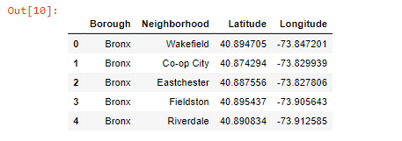
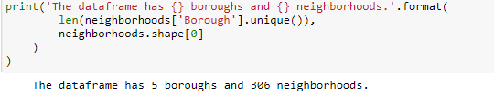
Data Source
I will be using NYC’s neighborhood data which was provided in the IBM Data Science Course in Module 3.
DF.head() for the New York Data provided.
DF.shape of the NYC data.

Slide 6
Methodology
Load NYC data into pandas data frames.
Link FourSquare API Credentials.
Create functions to retrieve venues, venue details, and location through FourSquare API.
Use functions to retrieve name, borough, neighborhood and ID for “Pizza Shops” through the FourSquare API. Save to local .csv due to limited API calls.
Use functions to retrieve details such as tips and reviews for the data in the saved .csv file.
Created DF by grouping ratings by neighborhood and borough.
Merge the created DF with the NY DF. The resulting DF should have neighborhood names, borough names, reviews, and lat/long coordinates.
Using Folium, create a map of NYC with markers on areas where Pizza Shops have a rating above 8.0 out of 10.

Slide 7
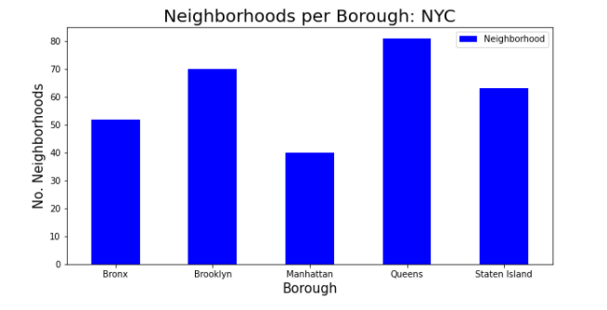
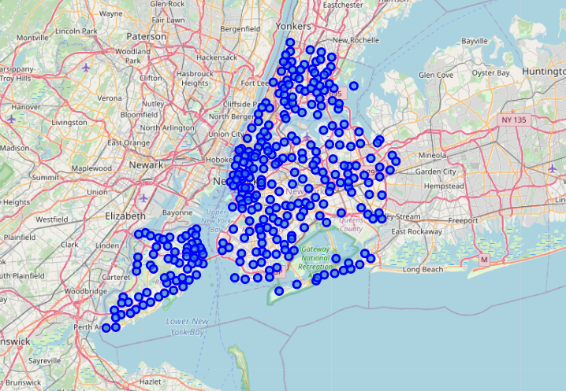
Results
This map and graph represents all the neighborhoods and boroughs that were explored through this capstone project.

Slide 8
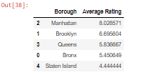
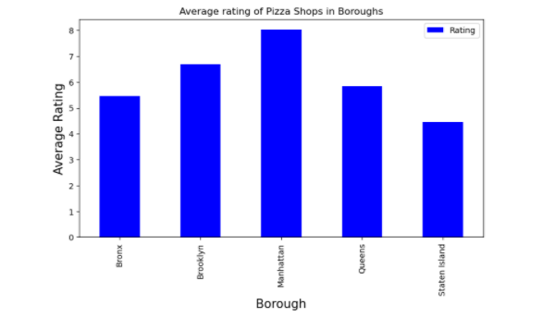
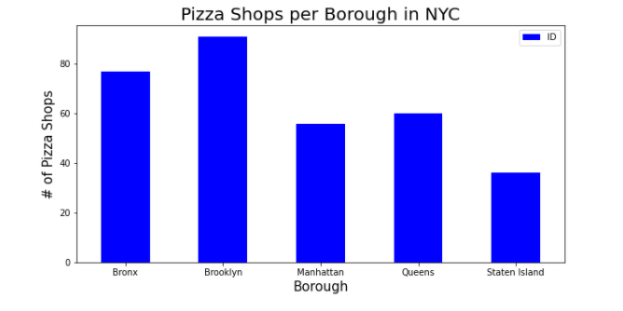
Results
We see from the data analysis that Brooklyn has the most pizza shops out of the 5 boroughs.
However, the highest average rated Pizza Shops are located in Manhattan.

Slide 9
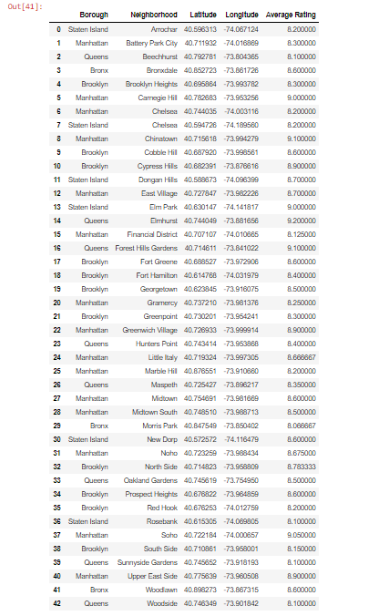
Results
This Data Frame represents the neighborhoods who have an average of 8.0 or higher merged with the NYC data frame.

Slide 10
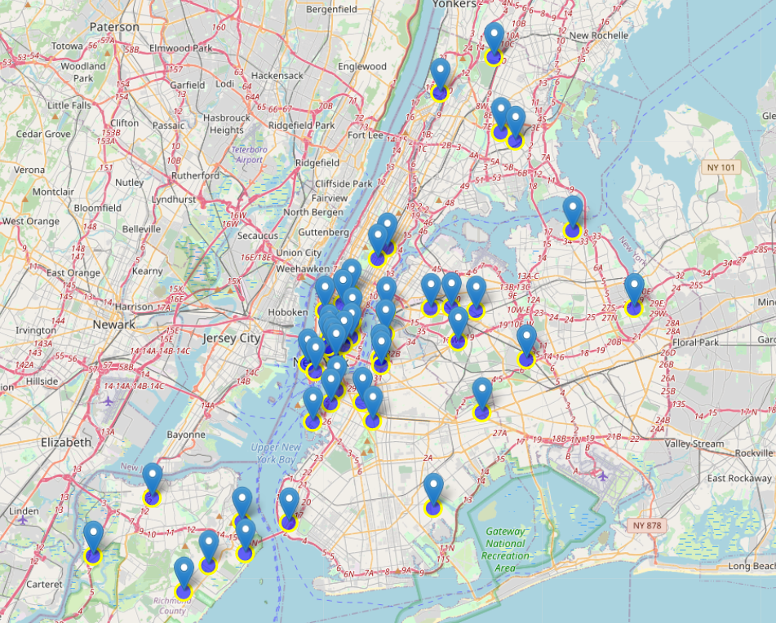
Results
This interactive map will allow clients to view the specific neighborhoods and its unique pizza shops’ average scores.

Slide 11

Conclusion
There were a total of 320 pizza shops found through FourSquare API.
Brooklyn has the highest number of pizza shops; however Manhattan has the highest rated pizza shops on average.
Manhattan has the least amount of neighborhoods, however, has a significant amount of pizza shops with high ratings.
Would not suggest opening a shop here unless the client was confident that they could contend with the competition.
Staten Island has the worst rated and least amount of pizza shops.
Staten Island is the best place for the client to start their quality pizza shop. Staten Island also has the 3rd most neighborhoods in New York City.

Slide 12

Further Studies
Using a different location API such as Google Location API might result in different results for the client.
More accurate analysis can be conducted if all databases containing reviews, tips, and location were used in this study.
Analyzing different cities for the client if they wish to proceed in another city.

